Slide 1
Data Analysis Level 4 Training
Introduction to Python programming language

Slide 2
Agenda
1.
Reasons to use Python
2.
Python in the Cloud
3.
Reasons to use Jupyter Notebook IDE
4.
Python operators and variables
5.
Python data types (data structures)
6.
Python programming constructs
7.
Accessing help in Python Jupyter Notebook
8.
Python libraries for data science
9.
Pandas library deep dive
10.
Pandas subsetting or slicing techniques
11.
Working with missing data
12.
Connecting to SQL Server
Page 2

Slide 3
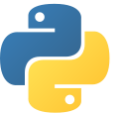


What is Python?
Let me know in the chat
Page 3
Notes:
Ask the group to answer the question in the chat.

Slide 4
What is Python?
Python is an open-source general-purpose coding language created by Guido van Rossum. It was released in 1991. Python is a beginner-friendly language – its syntax uses English keywords, making it easy for anyone to understand.
Page 4
Notes:
The definition above the image will appear with a click.

Slide 5
Reasons to use Python
Out of the box, Python’s standard library offers a wide range of facilities for:
String/text processing functionalities
I/O (input/output) functionalities
Numeric and mathematical functionalities
For more information, please refer to this link: https://docs.python.org/3/library/
Python also provides access to powerful data modelling capabilities through a vast array of packages, including NumPy, pandas, Matplotlib, SciPy, scikit-learn, and statsmodels, to name a few.
Page 5

Slide 6

Python in the cloud: Google Colab
Colaboratory, or ‘Colab’ for short, is a product from Google Research
Colab allows anybody to write and execute arbitrary Python code through the browser. It’s especially well suited to machine learning, data analysis and education
Google Colab is available here: https://colab.research.google.com/
Source: Google
Page 6
Notes:
-------------
Source:
Google. Google Colaboratory: Frequently Asked Questions. [online] Available at: <https://research.google.com/colaboratory/faq.html#:~:text=Colaboratory%2C%20or%20%E2%80%9CColab%E2%80%9D%20for,learning%2C%20data%20analysis%20and%20education.> [Accessed 24 January 2022].

Slide 7
Jupyter Notebook IDE
Page 7

Slide 8

Reasons to use Jupyter Notebook IDE
Jupyter Notebook is an open-source, easy-to-use web application that allows you to create and share documents that contain live code, equations, visualisations and narrative text
Uses of Jupyter Notebook include:
Data cleaning and transformation
Numerical simulation
Statistical modeling
Data visualisation
Machine learning
…and much more
Available through:
https://www.anaconda.com/products/individual
https://jupyter.org/install
Source: jupyter.org
Page 8
Notes:
-------------
Source:
Jupyter.org. Project Jupyter. [online] Available at: <https://jupyter.org/> [Accessed 24 January 2022].

Slide 9
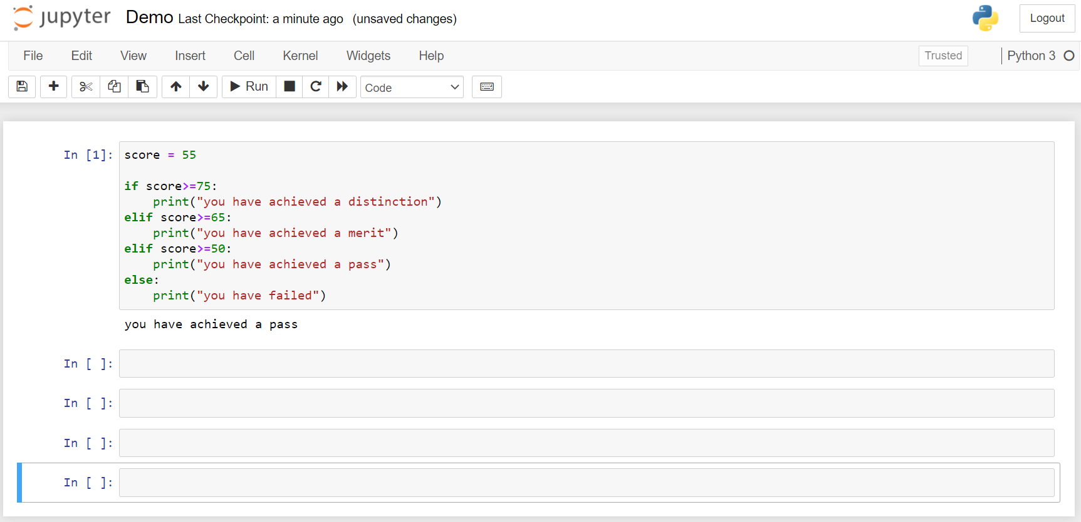
Jupyter Notebook’s graphical user interface
To execute or run a code cell:
press the Run button
press Shift + Enter
press CTRL+ Enter
Notebook
cells
Results are displayed here
Page 9

Slide 10
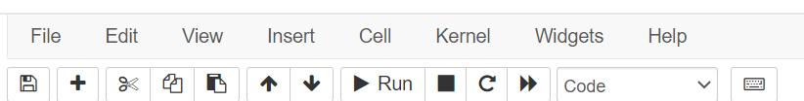
Jupyter Notebook’s toolbar
Cut, copy,
paste
Move cell
Run
cell
Reset
cell
Change
cell type
Save
New
cell
Stop
cell
execution

Slide 11
Python operators and variables
Page 11

Slide 12
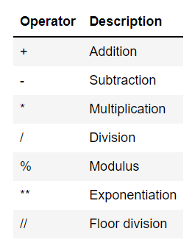
Python arithmetic operators
Here are some common arithmetic operators supported by Python:
Page 12

Slide 13
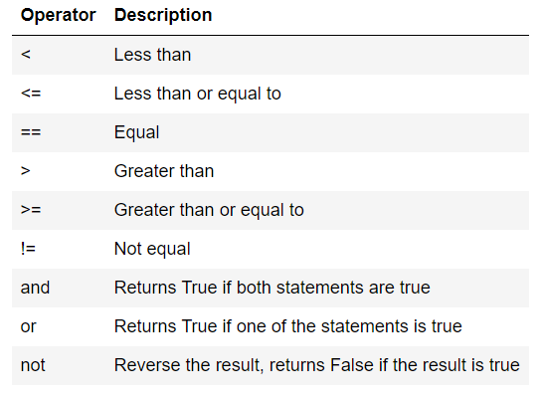
Python logical operators
In Python, logical operators are used while constructing conditional statements
The result of a logical operation is always true or false
Page 13

Slide 14
Python variables
In Python, logical operators are used while constructing conditional statements
The result of a logical operation is always true or false
Page 14

Slide 15
Python data types (data structures)
Page 15

Slide 16
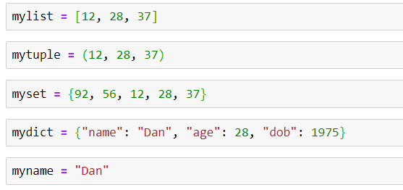
Python data types (data structures)
Every data value in Python has a data type
Every data value/variable in Python is an object
You can use the type() function to determine which data type a data value or a variable belongs to
Page 16

Slide 17
Python data types (data structures)
A data structure is a collection of data types
Data types can include strings, integers, floats, Booleans, and so on
A data structure is a specific way of storing and organising these data types in memory

Slide 18
Python data types (data structures)
In Python, the term data type and data structures are used interchangeably
The Python data structures most used in data science projects are:
Lists
Tuples
Sets
Dictionaries
Strings

Slide 19
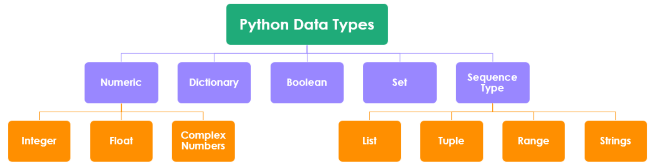
Python data types (data structures)
Page 19

Slide 20
Python lists
Lists are one of the most versatile and frequently used data types in Python
A list is a mutable(changeable) ordered sequence of items
In Python, a list is created by placing all the items inside square brackets [ ] and separating each item with commas
A list can contain any number of items with different data types (integer, float, string, etc.)
Source: Tutorial by EyeHunts
Page 20
Notes:
-------------
Source:
EyeHunts.com. 2018. Python Lists Tutorial | Examples of Improtant Lists Functions. [online] Available at: <https://tutorial.eyehunts.com/python/python-lists-tutorial-example/> [Accessed 24 January 2022].

Slide 21
Python tuples
A tuple is similar to a list in terms of indexing
A tuple is an immutable ordered sequence of items. This means that items inside a tuple can’t be changed or updated
In Python, a tuple is created by placing all the items inside parentheses ( ) and separating each item with commas
A tuple can contain any number of items with different data types (integer, float, string, etc.)
Page 21

Slide 22
Python sets
A set is an unordered and unindexed collection of items, without any duplicates. Every item in a set is unique
A set is created by placing all the items/elements inside curly braces { } and separating each item/element with commas.
It’s also possible to make a set using the set() constructor. This is useful when converting a list/tuple into a set
Sets can also be used to perform mathematical set operations, such as union, intersection, etc.
A set can contain any number of items with different data types (integer, float, string, etc.)
Sets are mutable(changeable)
Page 22

Slide 23
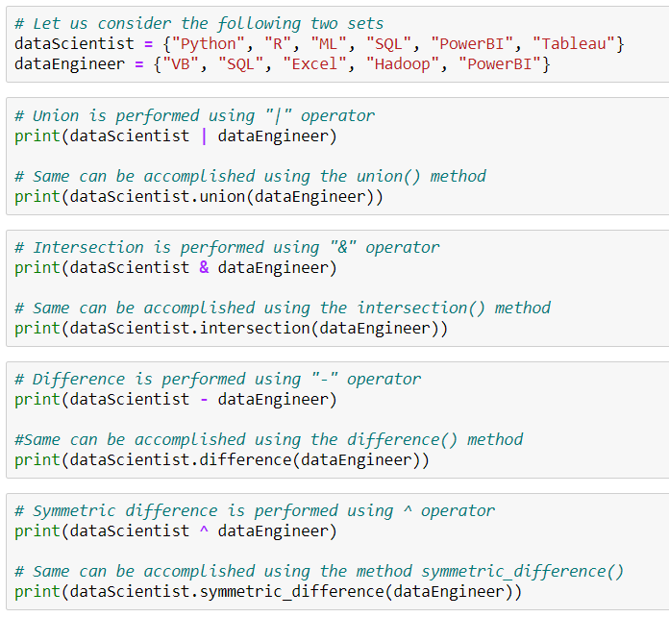
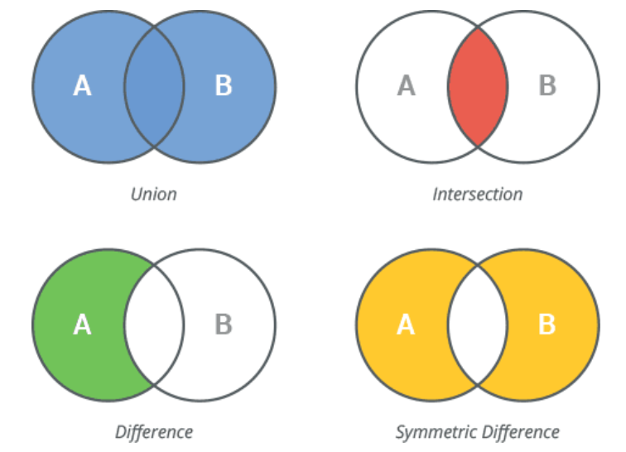
Python set operations
The union operator '|' combines two sets to form a new one that contains items from both
The intersection operator '&' gets items common only to both sets
The symmetric difference operator '^' gets items in either set, but not both (excluding the intersection)
Page 23
Notes:
(with slide 18) This is how data is combined in Python
Image
This is how it would be written in Python
1st sets out the two data sets they are working with.
Intro image – this is how the script is written in Python for a union operator

Slide 24
Python dictionary
A dictionary is a collection of items that are unordered, mutable and indexed
A dictionary is created by placing all items/elements inside curly braces { } and separating each item or element with commas. Each item in a dictionary should have a key/value pair
We can also create a dictionary using the built-in dict() function
An item has a key(unique index) and a corresponding value that is expressed as a pair (key: value)
Page 24

Slide 25
Python strings
Strings are arrays of bytes that represent unicode characters
A string is a collection of one or more characters inside quotation marks
In Python, any one/single character is a string of length one. It is represented by str class
Page 25
Notes:
String hotspot 1

Slide 26
Python built-in open function to read strings
Page 26

Slide 27
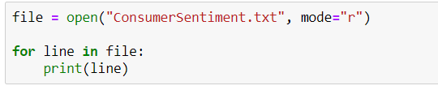
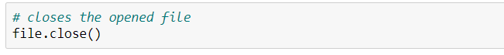
Python built-in open() function to read strings

Slide 28
Python built-in open() function to read strings
The open() built-in function is used to open files in your system. It takes two arguments: the name of the file and the mode.

Slide 29
Python built-in open() function to read strings

Slide 30
Python built-in open() function to read strings
The filename is the name of the file to be opened. The mode indicates how the file is going to be opened: 'r' for reading, 'w' for writing and 'a' for appending.

Slide 31
Python built-in open() function to read strings

Slide 32
Python built-in open() function to read strings
The default mode for opening a file is 'r'.

Slide 33
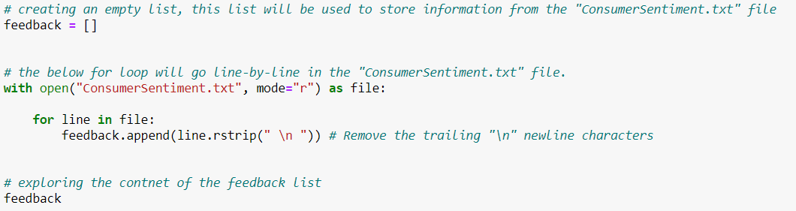
With open() function (string)
With the 'With' statement, you get better exceptions handling
The ‘With’ statement will automatically close the file, so there’s no need to execute file.close()
Page 33

Slide 34
Python programming constructs
Page 34

Slide 35



Programming constructs
Programming constructs are used to control the order in which instructions are executed
In programming languages such as SQL, R and Python, the expression that translates to an instruction is called a programming statement
All programming languages support the following programming constructs. One or more of these programming constructs can be used repeatedly based on the complexity of the program
Sequencing
Selection
Iteration
Page 35
Notes:
Additional text to accompany the programming constructs
Sequencing: When your code runs from top to bottom, one line at a time. It will start from line 1, then execute line 2, line 3, and so on until the end of your program
Selection: When you would like to run code conditionally. Here is where you’ll use ‘CASE’ and ‘IF’ statements
Iteration: When you want to execute the same lines of code several times. There are three types of loops to achieve this: ‘FOR’ loops, ‘WHILE’ loops and ‘REPEAT UNTIL’ loops. This prevents repetition and reduces the length of your code

Slide 36
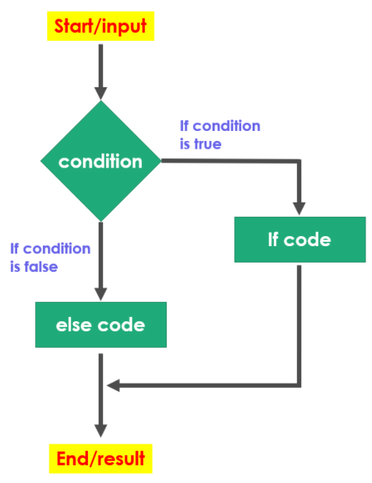
Python if/else statements (conditional statements)
If/else statements help us to run a particular code only when a certain condition is satisfied
If/else statements make use of logical operators while defining the condition
if/else logic can be extended using nested if conditions
Page 36

Slide 37
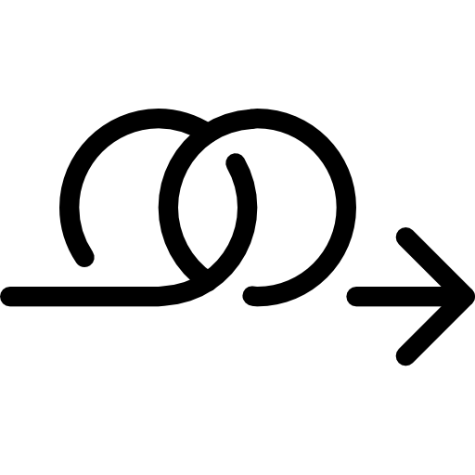

Python loops
In general, loops are used to execute statements sequentially
Loops are useful when you want to iterate through lists, tuples, dictionaries, sets, or strings and perform calculations
There are two types of loops used in Python:
For loop
While loop
Page 37

Slide 38

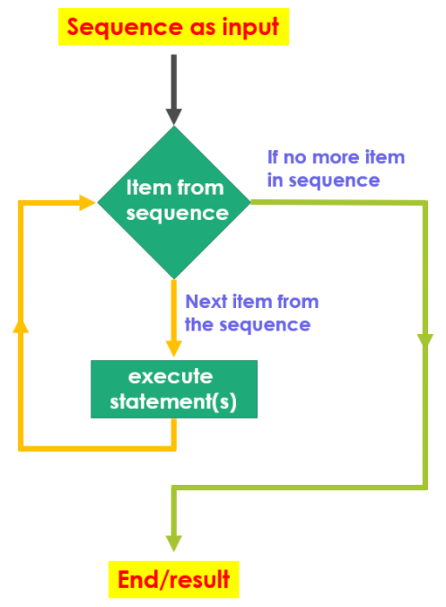
Python for loop
A for loop is used for iterating through a sequence (such as a list, tuple, dictionary, set, or string)
The for loop allows for the execution of a set of statements, once for each item in the list, tuple, set, etc.
Page 38

Slide 39
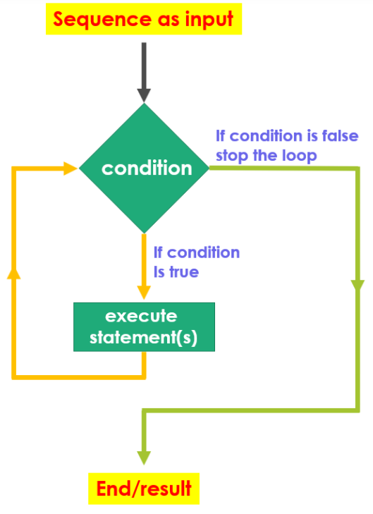
Python while loop
With the while loop, we can execute set of statements as long as the specified condition is true
Page 39

Slide 40
Accessing help in Python Jupyter notebook
Below are three techniques that can be used to access help documentation in Python:
1
2
3
Place your mouse key anywhere within the body of the function.
If you need help with a particular function, type the function name into a cell within Python followed by a question mark.
Use Python’s built-in help() function to access help documentation about all Python objects, such as data types and functions.
Hold down the SHIFT key, and then press the TAB key.
The general syntax for help is: help(object-name)
For example, you would use:
For example, if you’d like help with using the round() function, you’d type ‘round?’.
To access extended help, repeat the above step, but this time, press the TAB key twice.
Data-type help à help(list_name)
Function help à help(round)
Module help à help(math)

Slide 41
Python libraries for data science
Page 41

Slide 42
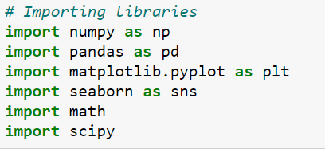
Loading Python libraries
To make use of the functions in a library, you’ll need to import with an import statement
An import statement is made up of the keyword ‘import’, along with the name of the library. The keyword ‘as’ can be used to assign an alias
Page 42

Slide 43
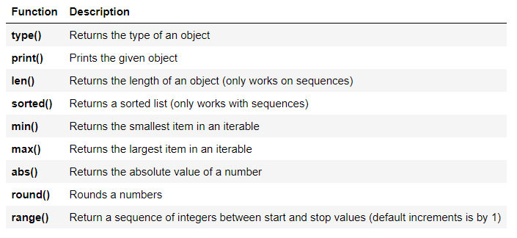
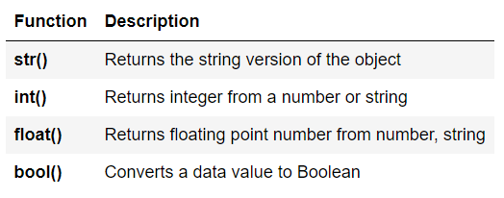
Python built-in functions – standard library
Out of the box (without any importing), Python’s standard library offers a wide range of facilities for:
String/text processing functionalities
I/O (input/output) functionalities
Numeric and mathematical functionalities
Python has several built-in functions that its standard library covers:
For more information, refer to this link: https://docs.python.org/3/library/
Page 43

Slide 44
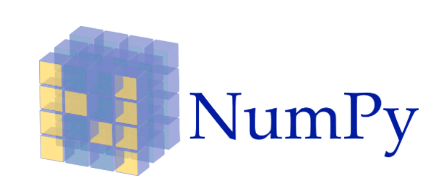
NumPy
NumPy stands for Numerical Python
NumPy is the core library for scientific computing in Python
NumPy provides multidimensional array objects and tools for working with these arrays
Many other Python libraries are built on NumPy
Link: http://www.numpy.org/
Page 44

Slide 45
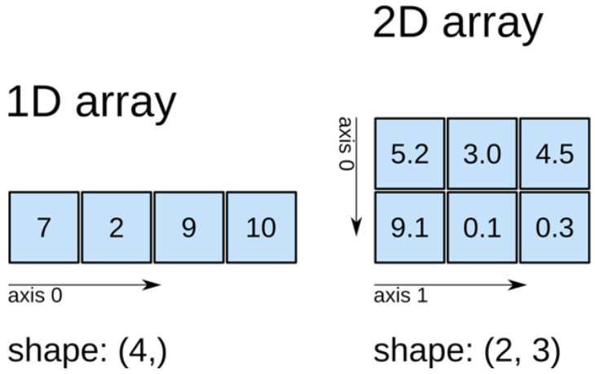
NumPy ‘array’ data object
NumPy provides array data objects (data structures) that are up to 50x faster than Python lists
NumPy arrays are called ‘ndarrays’ (n dimensional arrays)
Arrays are homogeneous multidimensional structures
Arrays are a grid of values that share the same data type, and are indexed by a tuple of non-negative integers
NumPy dimensions are called axes
Page 45

Slide 46

Pandas
Pandas is a high-level data manipulation library
It’s built on the NumPy package and provides two valuable data structures: Series and DataFrame
DataFrame allows you to store and manipulate tabular data in rows and columns
Link: http://pandas.pydata.org/
Page 46

Slide 47

SciPy
SciPy (pronounced ‘Sigh Pie’) is an open-source software for mathematics, science, and engineering. It’s also built on Numpy
SciPy stands for Scientific Python.
SciPy has optimised and added functions that are frequently used in NumPy and data science
Link: https://www.scipy.org/scipylib/
Page 47

Slide 48

Scikit-learn
Scikit-learn is a free machine learning library that provides many unsupervised and supervised learning algorithms for classification, regression and clustering
It’s built on NumPy, SciPy, and matplotlib
Link: http://scikit-learn.org/
Page 48

Slide 49

Matplotlib
Matplotlib is an open-source, cross-platform data visualisation and graphical plotting library for Python
Link: https://matplotlib.org/
Page 49

Slide 50

Seaborn
Based on Matplotlib, Seaborn provides high-level interface for drawing attractive statistical graphics
It’s similar (in style) to the popular ggplot2 library in R
Link: https://seaborn.pydata.org/
Page 50

Slide 51
Pandas library deep dive
Page 51

Slide 52
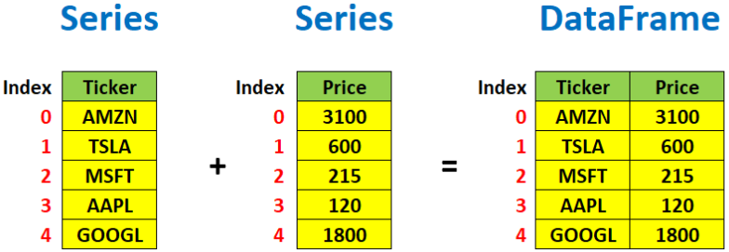
Pandas data structures
Pandas Series is a one-dimensional labelled array that can hold any data type. It can have axis labels or an index
An example of a Series object is one column from a DataFrame
Indexing in a pandas Series starts from 0
Page 52
Notes:
Additional text to convey with the slide: Pandas DataFrame is a 2-dimensional labelled data structure with columns of potentially different types. You can think of it like a spreadsheet or SQL table, or a dictionary of Series objects. It is generally the most commonly used pandas’ object. Like Series, DataFrame accepts many different kinds of inputs. Indexing in a panda DataFrame starts from 0 (for both rows and columns)

Slide 53
Pandas data frame data types
The following methods can be used to explore Pandas data frames:
Pandas type | Native Python type | Description
object | string | The most general dtype. It will be assigned to your column if the column has mixed types (numbers and strings).
int64 | int | Numeric characters. 64 refers to the memory allocated to hold this character.
float64 | float | Numeric characters with decimals. If a column contains numbers and NaNs(see below), Pandas will default to float64, in case your missing value has a decimal.
datetime64, timedelta[ns] | N/A (but see the datetime module in Python’s standard library) | Values meant to hold time data. Look into these for time series experiments.
Page 53

Slide 54
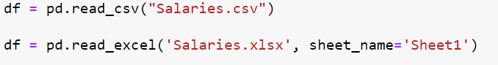
Reading data using pandas
There are several Pandas commands for reading data files. The most popular are CSV and EXCEL.
Page 54

Slide 55
Pandas data frame methods
The following methods can be used to explore Pandas data frames:
df.method() | description
head( [n] ), tail( [n] ) | first/last n rows
describe() | generate descriptive statistics (for numeric columns only)
max(), min() | return max/min values for all numeric columns
mean(), median() | return mean/median values for all numeric columns
std() | standard deviation
sample([n]) | return a random sample of the data frame
dropna() | drop all the records with missing values
groupby() | group data based on some criteria and calculate summary statistics
Page 55

Slide 56
Pandas data frame attributes
The following methods can be used to explore Pandas data frames:
df.attribute | description
dtypes | list the types of columns
columns | list the column names
axes | list the row labels and column names
ndim | number of dimensions
size | number of elements
shape | return a tuple representing the dimensionality
values | numpy representation of the data
Page 56

Slide 57
Pandas subsetting or slicing techniques
Page 57

Slide 58

Pandas subsetting or slicing techniques
We’ll be exploring four slicing techniques:
Using square brackets []
1.
2.
Using logical (Boolean) expressions method
3.
Using loc[ ] method
4.
Using iloc[ ] method
Page 58

Slide 59
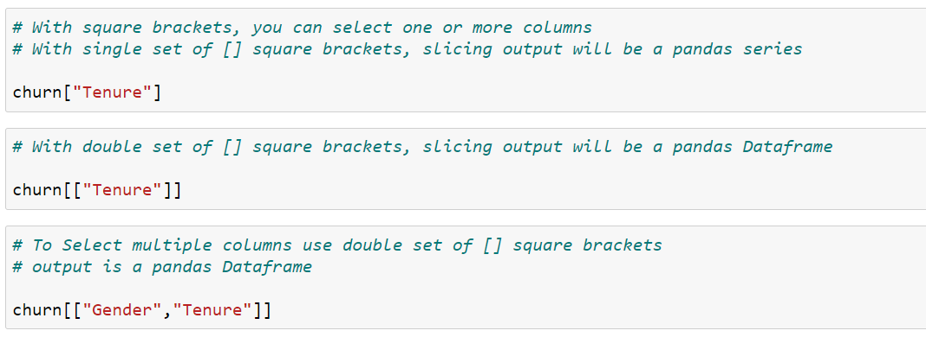
1. Using square brackets [ ]
Page 59

Slide 60
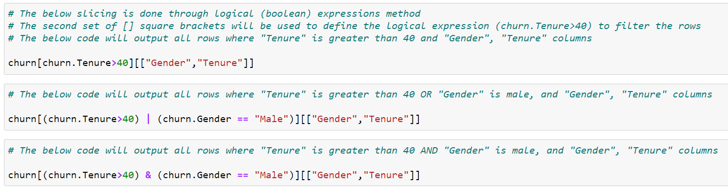
2. Using logical (Boolean) expressions method
Page 60

Slide 61
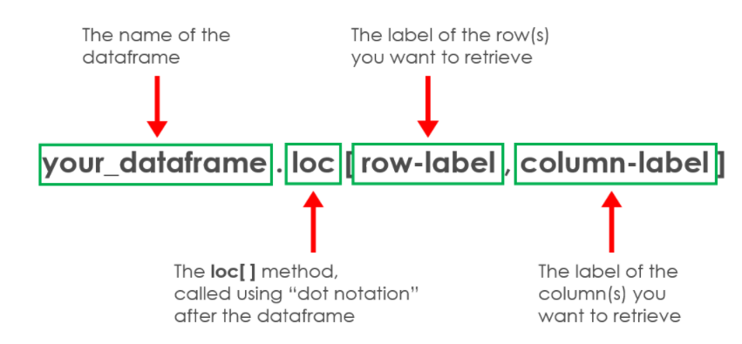
3. Using loc[ ] method
The pandas attribute .loc will allow you to select rows and columns in the following way:
Page 61

Slide 62
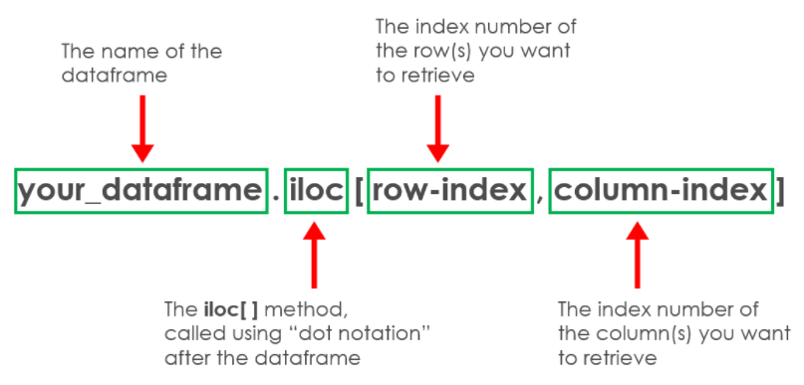
4. Using iloc[ ] method
The pandas attribute .iloc will allow you to select rows and columns in the following way:
Page 62

Slide 63
Working with missing data
Page 63

Slide 64
Working with missing data
Missing data can occur when no information is provided
In Pandas, missing data is represented by two values: None and NaN (an acronym for Not a Number)
None and NaN aare essentially interchangeable for indicating missing or null values
There are several useful functions for detecting, removing, and replacing null values in Pandas DataFrame
These functions can also be used in Pandas Series:
isnull()
notnull()
dropna()
fillna()
replace()
interpolate()
Page 64

Slide 65
Connecting to a Microsoft SQL server
Page 65

Slide 66
Using pyodbc to connect to MS SQL
Pyodbc is an open-source Python library that makes accessing ODBC databases, such as Microsoft SQL sever, possible. Once the pyodbc connection has been established, you can execute SQL statements to extract data from a database.
There are seven main settings needed to make a connection:
1.
Driver
2.
Server
3.
Database
4.
UID
Trusted
connection
5.
PWD
6.
Port
7.
Page 66
Notes:
Additional text to include with points 1-7:
1. Driver – This is known as SQL Server 2019 connection string
2. Server – This isa network path to the database server
3. Database – This is the name of the database
4. UID – This is the user's network ID or SQL server local account name
5. PWD – This is the account's password
6. Port – This should be set to 1433
7. Trusted_connection – This should be always used while connecting to a local instance of MS SQL using Windows credentials

Slide 67
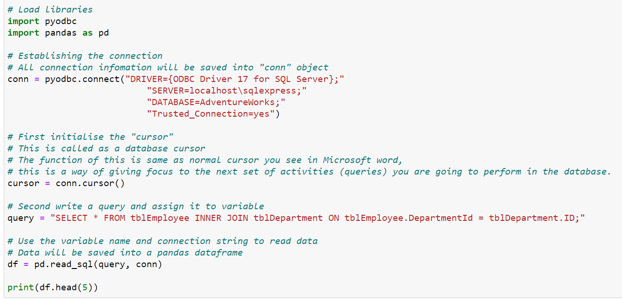
Using Pyodbc to connect to MS SQL
Page 67

Slide 68

Questions?
Page 68

Slide 69
Summary
1.
Reasons to use Python
2.
Python in the Cloud
3.
Reasons to use Jupyter Notebook IDE
4.
Python operators and variables
5.
Python data types (data structures)
6.
Python programming constructs
7.
Accessing help in Python Jupyter Notebook
8.
Python libraries for data science
9.
Pandas library deep dive
10.
Pandas subsetting or slicing techniques
11.
Working with missing data
12.
Connecting to SQL Server
Page 69

Slide 70
Thank you
careers@archapprentices.co.uk
www.archapprentices.co.uk
Page 70

